Slide 1

The Google VR SDK

Slide 2

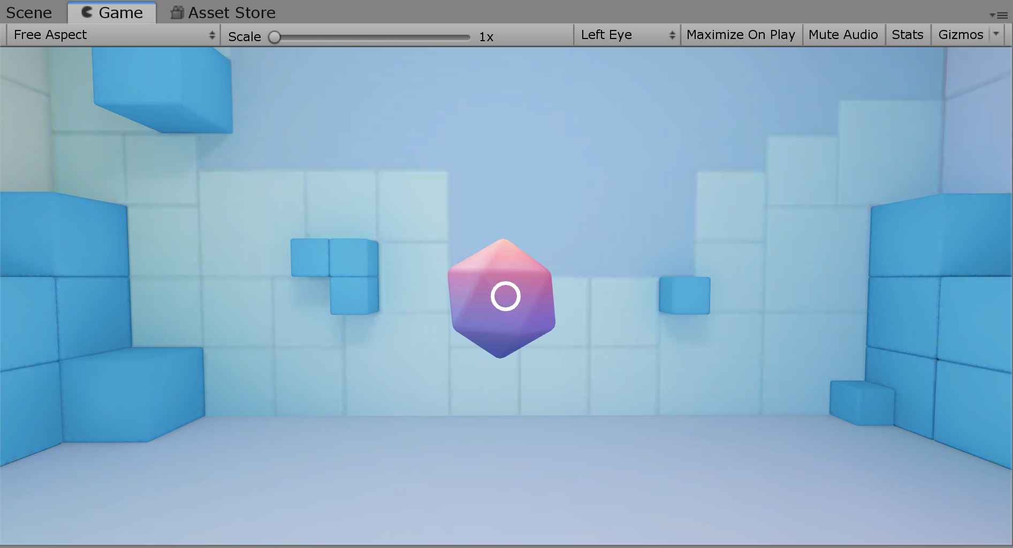
Installing Google VR SDK
Take the time to install the Google VR SDK
Follow the instructions available here: https://schoolofgames.github.io/DPIWorkshop.html
We will be available to help you if you need any assistance
Once you have installed the SDK and imported the demo
Try the demo on your phone
Start exploring the Unity project
Try to understand how it works

Slide 3
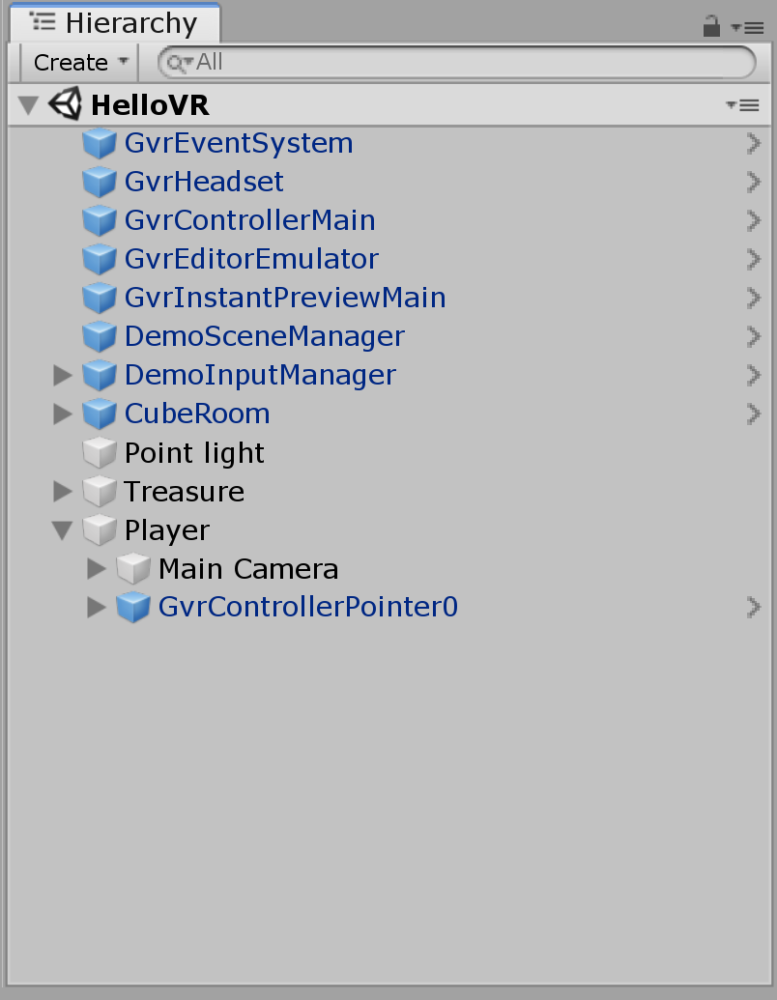
Google VR demo
You might notice that the hierarchy windows contains multiple objects with the Gvr prefix
Those are objects provided by the Google VR SDK to take care of core VR functionalities
Most of those files are not useful when using only Cardboard

Slide 4
Google VR demo
The two objects that are important are
GvrEventSystem
GvrEditorEmulator
GvrEventSystem handles the events generated by the pointer
Required to handle user inputs
GvrEditorEmulator allows you to control the VR camera while running the app in the Unity editor

Slide 5
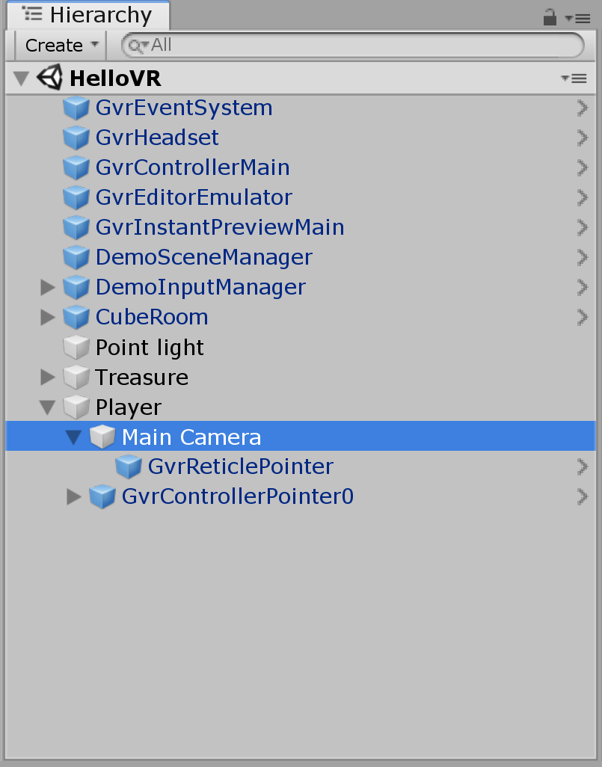
VR Camera
The demo uses a standard camera and the stereoscopic vision is handled automatically
However additional functionalities are added to the camera
A GvrReticlePointer object (provided by the SDK) is added as a child of the camera
This object draws the aiming reticle

Slide 6
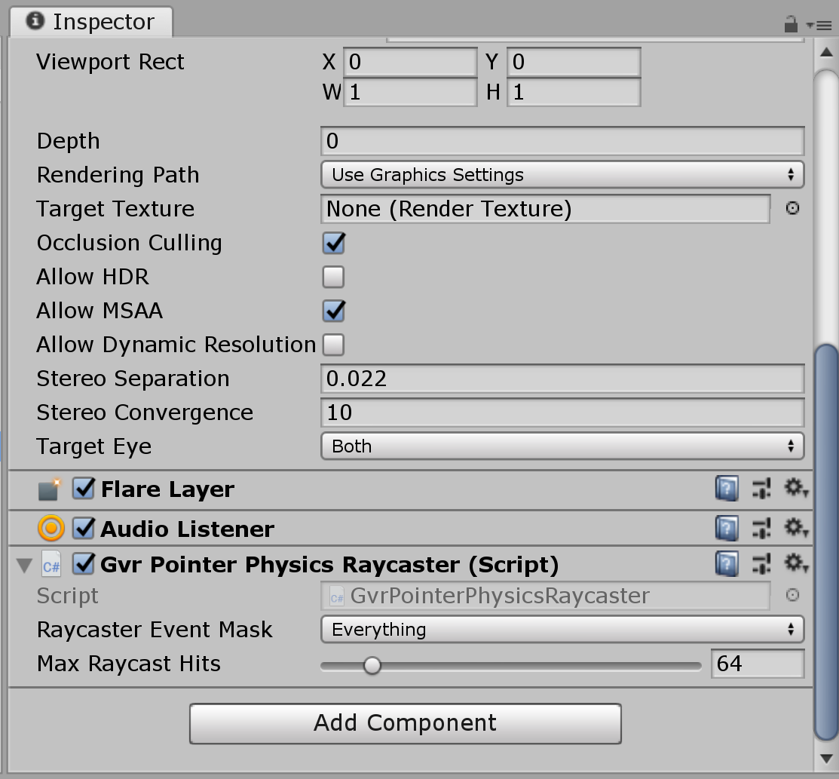
VR Camera
A GvrPointerPhysicsRaycaster component is added to the camera
Raycasting allows the camera to send an invisible “ray” from its center towards where the camera is pointing
The application can know which object the user is looking at, by evaluating which object the ray collides with

Slide 7
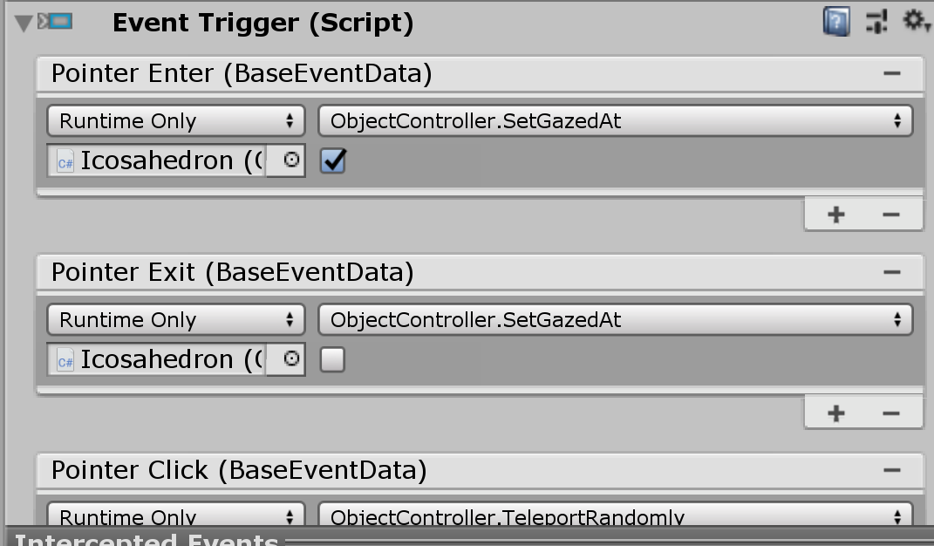
VR Inputs
In the demo, inputs generate events that are captured by the game objects
To allow an object to capture events
Make sure that the object has a collider (to handle collision with the ray)
Add an Event Trigger component

Slide 8
VR Inputs
The event trigger component allows the object to receive events related to the pointer
Such as
Pointer Enter
Pointer Exit
Pointer Click

Slide 9
VR Inputs
Each trigger has an object associated to it and a script to execute when the event is triggered

Slide 10
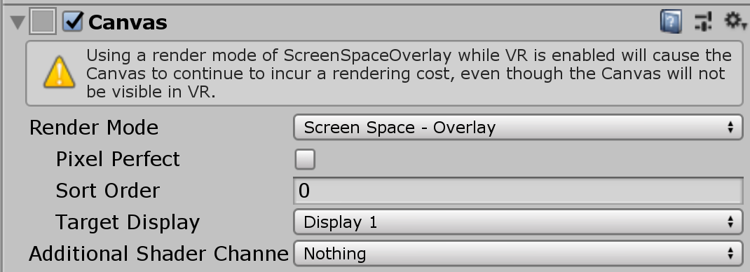
Heads up display in VR
By default, Unity Canvases are rendered as an overlay on the screen
However, this doesn’t work in VR

Slide 11
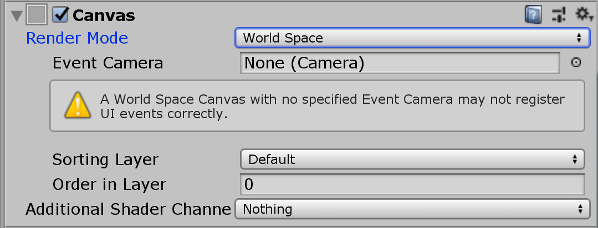
Heads up display in VR
Instead, the Canvas’s render mode needs to be set as “World Space”
Doing so, the canvas will act as a game object that can be positioned and moved in the world space

Slide 12
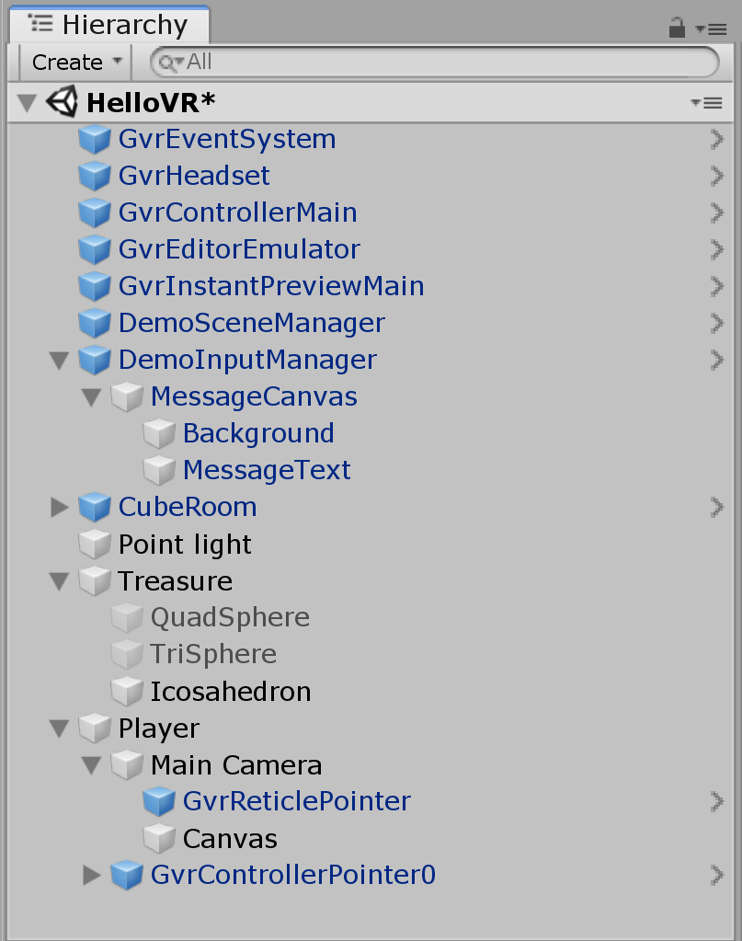
Heads up display in VR
Since we want this canvas to act as a head up display, it needs to move with the camera
This can be achieved by making the canvas a child of the camera game object
Doing this, any transformation applied to the camera will also be applied to the canvas

Slide 13
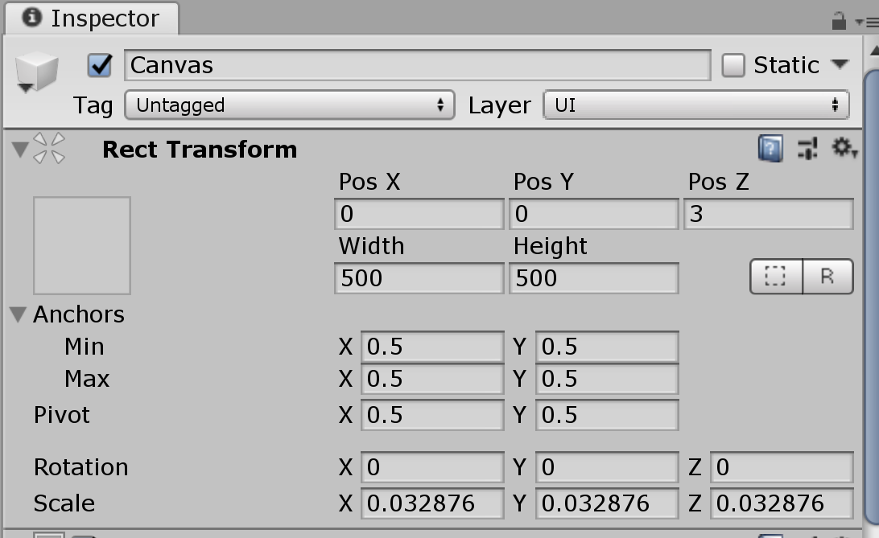
Heads up display in VR
Reset the camera transform and adjust its “Pos Z” so it’s always in front of the camera
You will need to greatly reduce the scale of your canvas to make it fit within the vision area of your camera
This may require some fine tuning until you find something that works well for you
Make sure the scale values are positive (otherwise the canvas will appear inverted)

Slide 14
VR Demo Extensions
Modify the VR demo to add a new functionality
Suggestions:
Rotate the objects when they are targeted
Keep a count of how many objects have been found and display the count on a head up display
Add new types of targets

